Slide 1

Introduction to the FIFA World Cup
The FIFA World Cup is the most prestigious football tournament in the world. Held every four years, it showcases top national teams competing for glory.
by Sachin

Slide 2
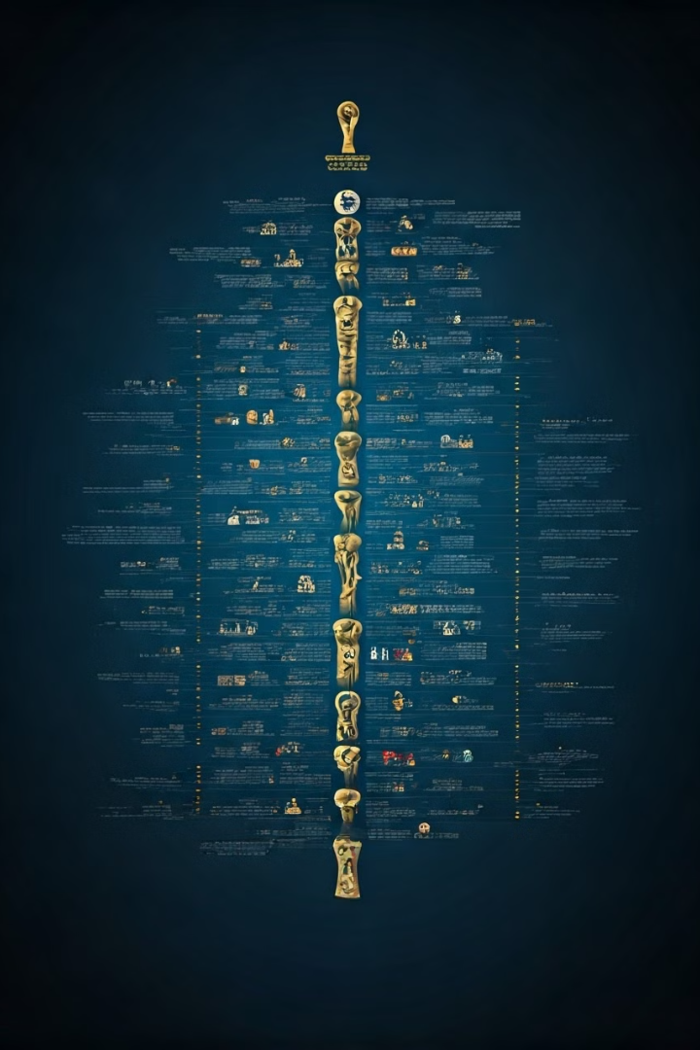
Historical Overview (1930-2014)
1
First Tournament (1930)
The first World Cup was held in Uruguay and featured 13 teams.
2
Golden Era (1950s-1970s)
This period saw the rise of iconic players and memorable matches.
3
Modern Era (1990s-Present)
The tournament expanded to 32 teams, becoming a global spectacle.

Slide 3
Dataset: WorldCups
Overview
Usage
Visual Insights
This dataset contains information about each World Cup tournament.
Used for analyzing historical World Cup data and trends.
Aids in understanding which countries dominate the tournament.
Years
Identifying trends
Hosts
Comparing performances
Winning frequencies
Winners
Geographic trends

Slide 4
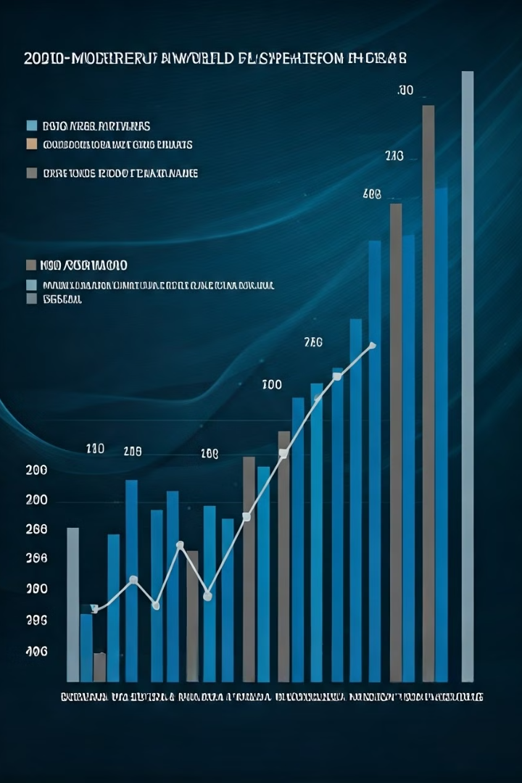
Dataset: WorldCupMatches
1
Total Matches
Over 900 matches have been played across all tournaments.
2
Notable Matches
Memorable games have defined the tournament's history.
3
Goals Statistics
Analysis offers insights into scoring patterns over decades.

Slide 5




Dataset: WorldCupPlayers
Top Scorers
Highlights the leading goal scorers in World Cup history.
Most Appearances
Celebrates players with the highest match appearances.
Legendary Players
Focus on players who shaped the tournament's legacy.

Slide 6
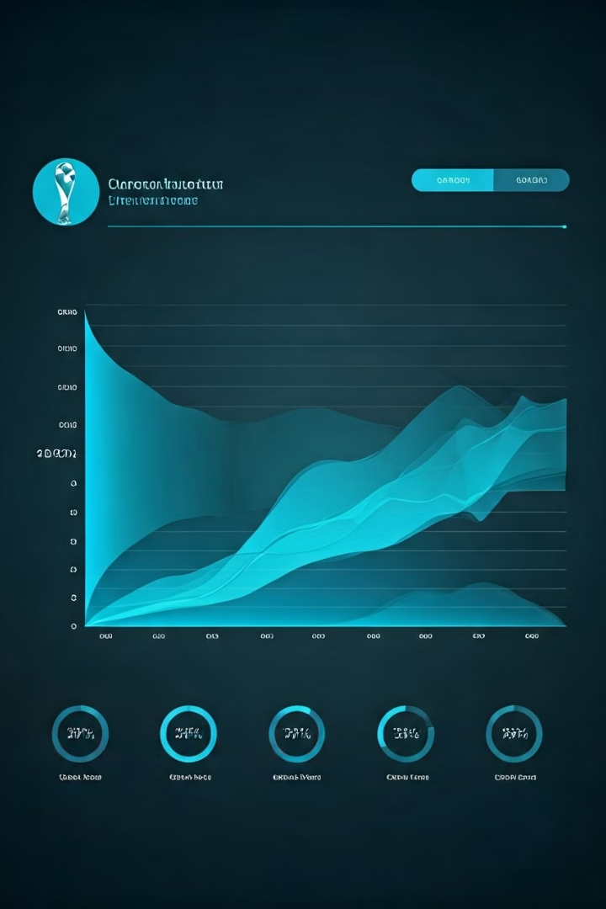
Key Insights and Trends
1
Dominating Teams
Certain countries consistently outperform others in World Cups.
2
Emerging Nations
New teams are increasingly becoming competitive.
3
Historical Patterns
Trends give insight into the evolution of style and tactics.

Slide 7


Visualizations and Analysis
Memorable Moments
Statistical Breakdowns
Images capture the unforgettable scenes from past tournaments.
Visual representation of key statistics and analytics.

Slide 8

Conclusion and Takeaways
The FIFA World Cup is a rich tapestry of history and competition. Understanding the datasets can offer deeper insights into football's global impact.
In future tournaments, data will continue to enhance our experience and understanding.

